Slide 1
Module 2

Slide 2
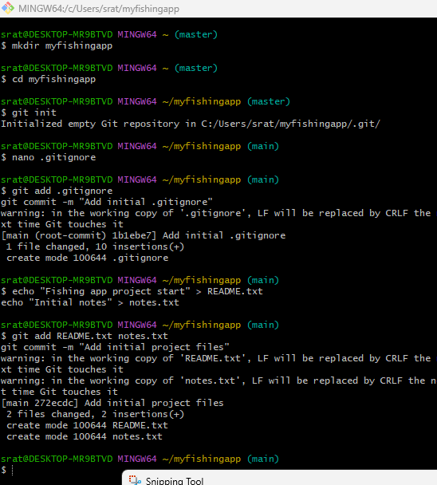
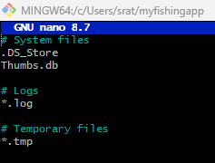

Created a new folder for my project.
Created a local Git Repository.
Created a .gitignore file to show which files to ignore.
Nano text editor
.DS_Store
Thumbs.db
*.log
*.tmp
Staged before the commit.
First commit.
Created README file and notes file.
Staged the files that were created.
Committed the files.
Used to check if my .gitignore files are in nano.

Slide 3
Module 4

Slide 4
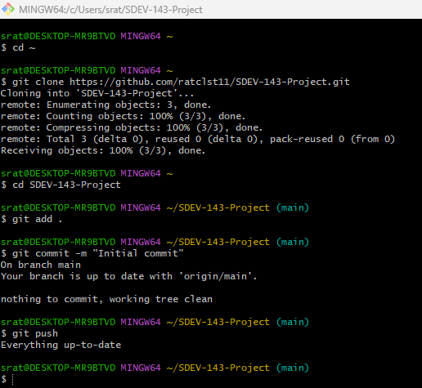
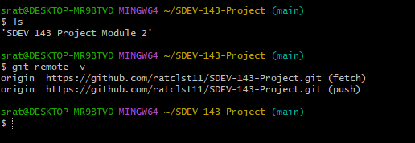
Linking my repository locally
Created a local folder
Initialized a Git repo inside of it
Check the remote connection is working

Slide 5
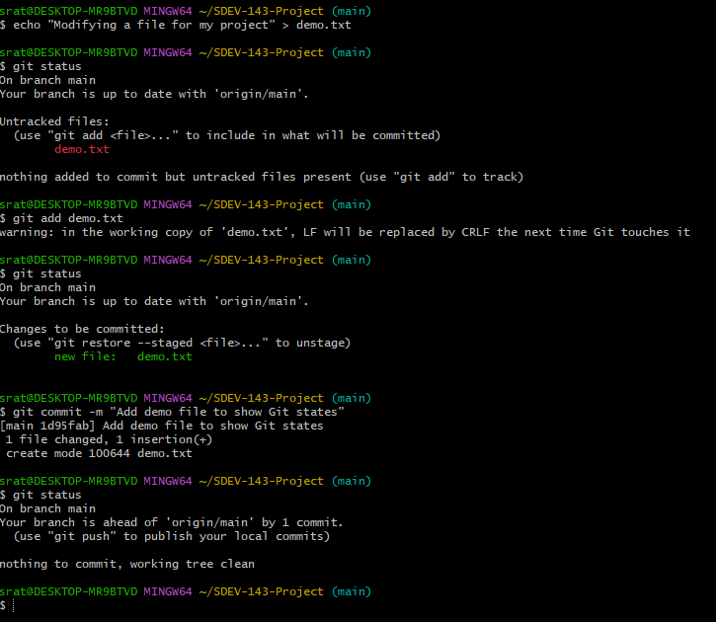
Modifying a file
Created a file that is staged (In Red)
Changes to be committed
Changes to be committed (In Green)
Committing the file
Files committed

Slide 6
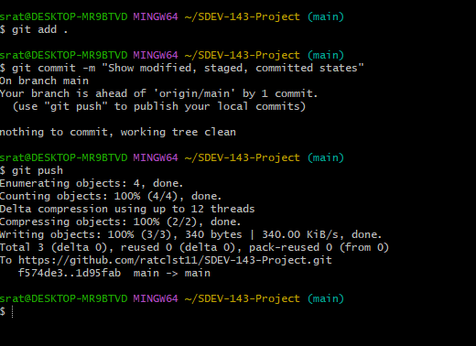
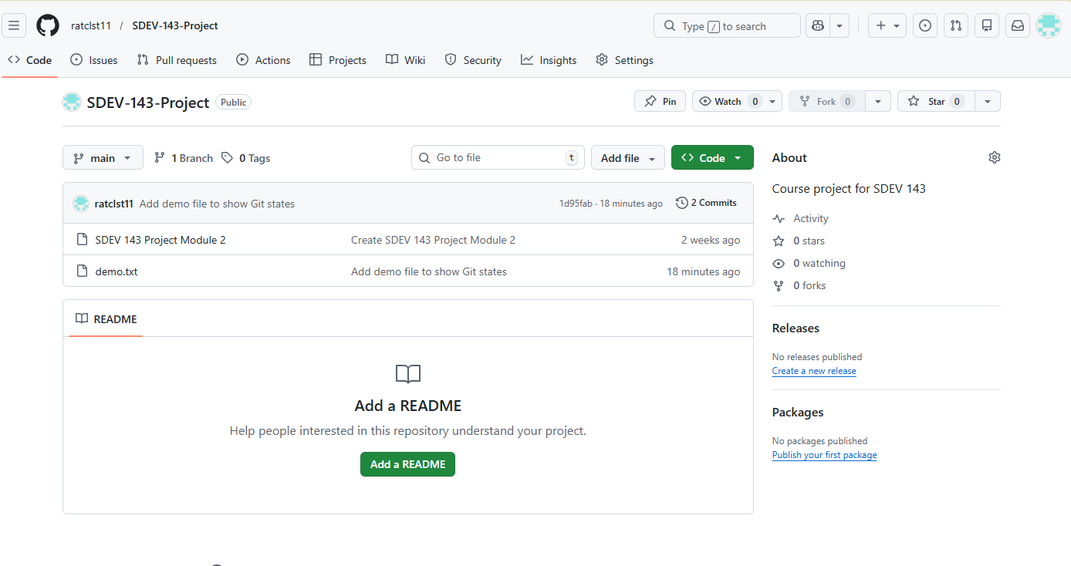
Add commit anything new.
Pushed to my repo
File in my repo.

Slide 7
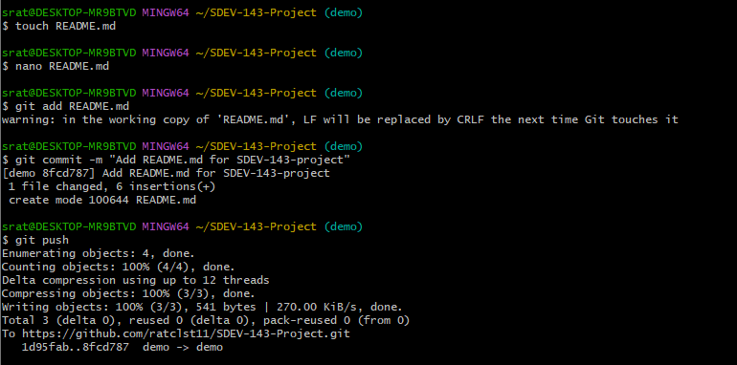
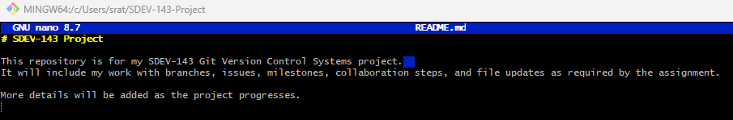
Add a README in the wrong branch “demo”
Add a new file with “touch”
Text editor “nano”
Stage the README
Commit the README
Push to GitHub
README file in “nano””

Slide 8
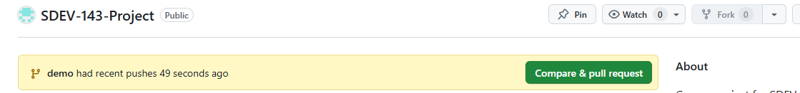
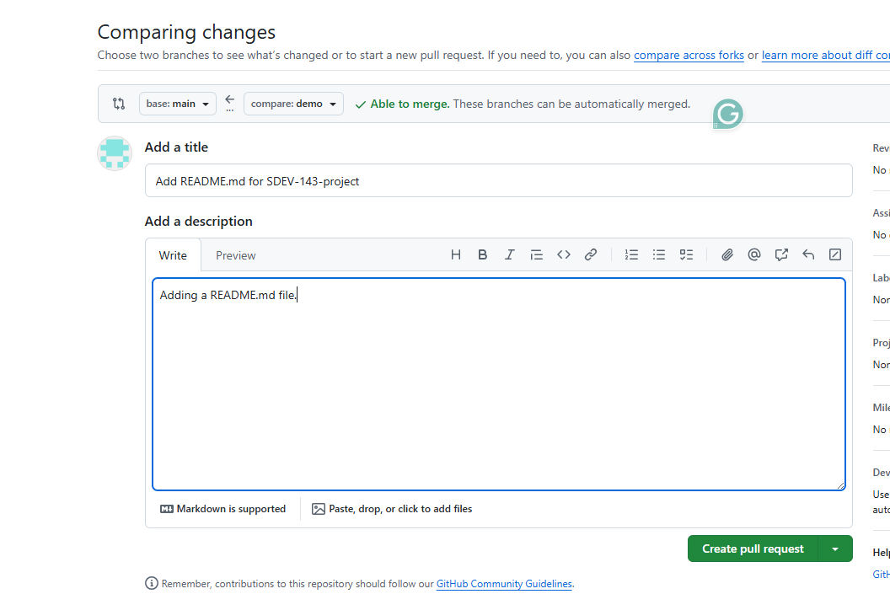
Pull Request for README.md
Create a scenario to create a pull request

Slide 9
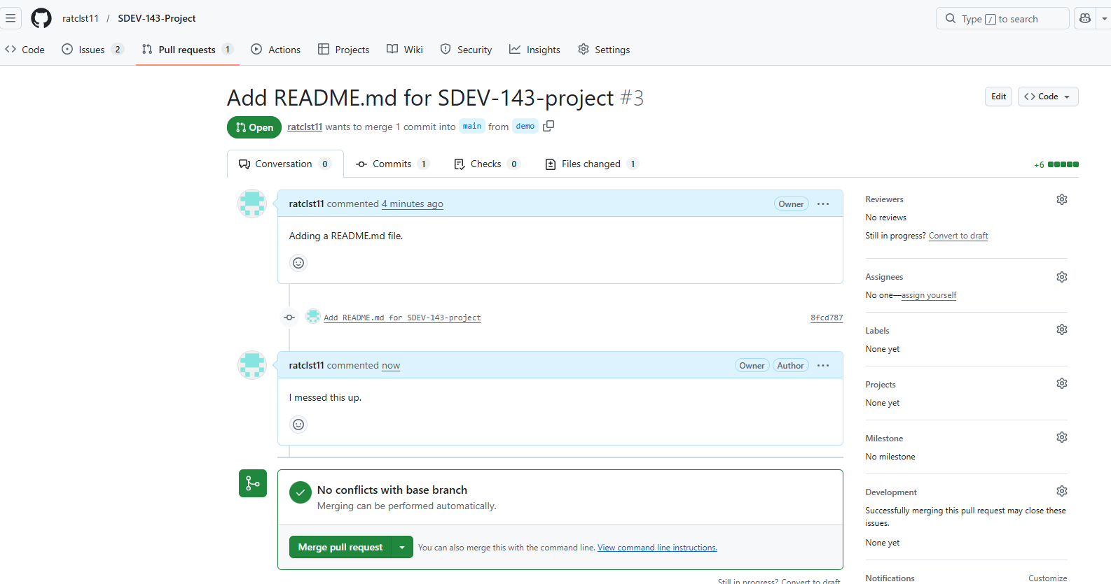

Slide 10
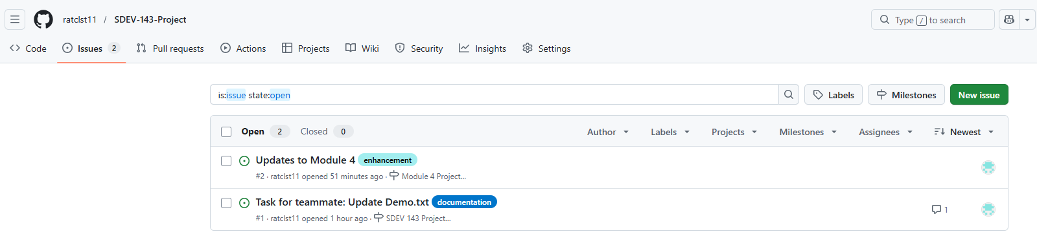
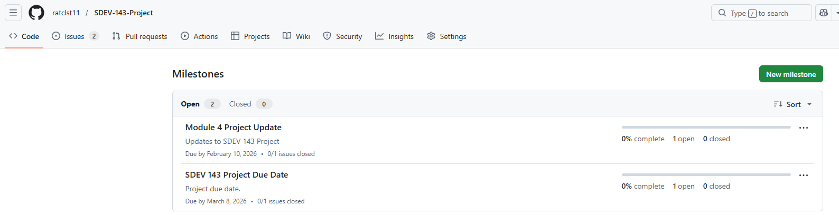
Creating a Milestone

Slide 11
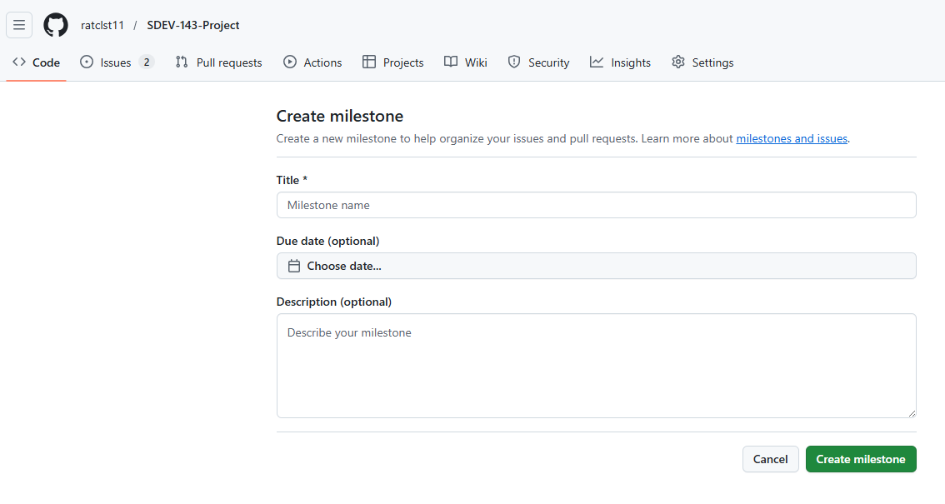
Create a title
Give a Due Date
Add a Description
Click GREEN Create milestone

Slide 12
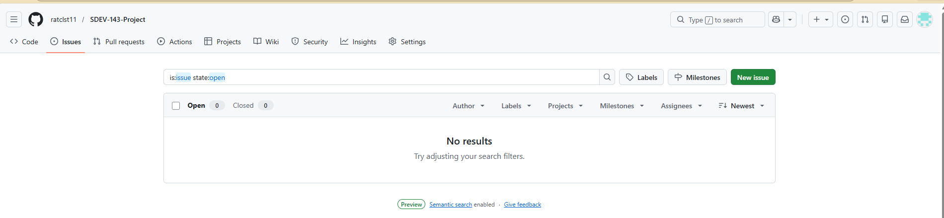
Creating an issue
Select issues
Click the GREEN New issue button

Slide 13
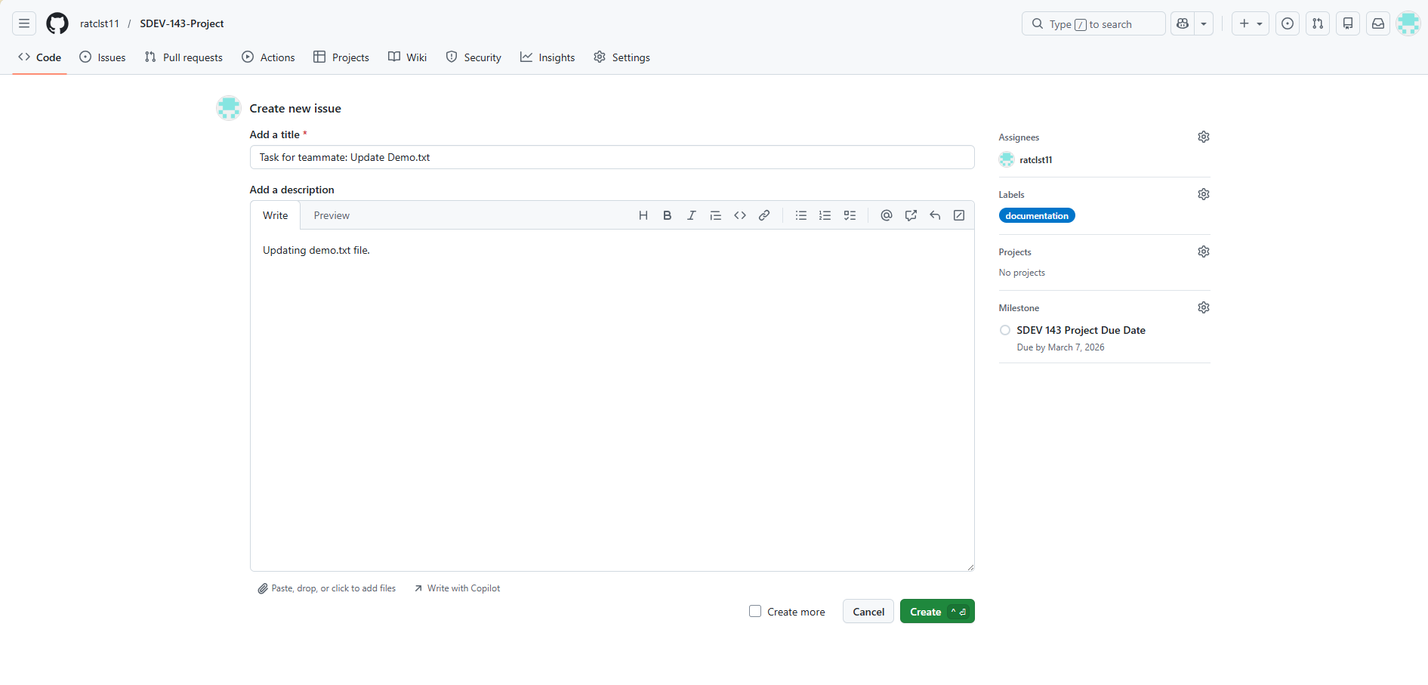
Assign the issue
Add a title
Add a description
Assign a label
Assign the Milestone that was created
Click GREEN Create button

Slide 14
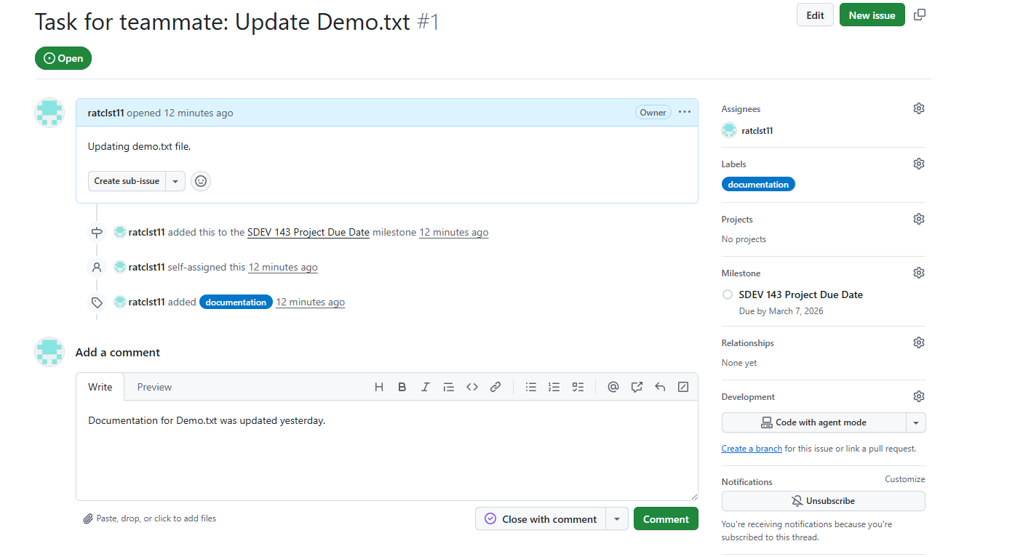
Make a comment
Add a comment
Select Comment in GREEN

Slide 15
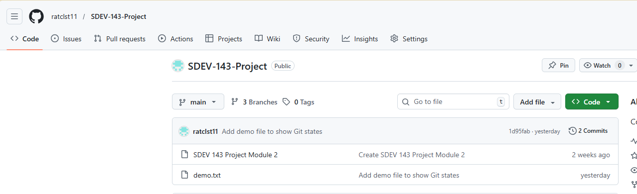
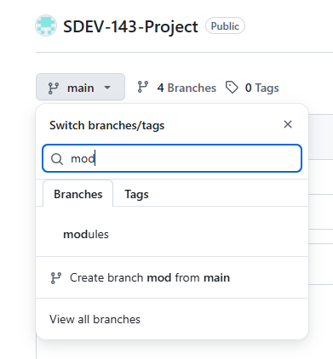
Select main
Drop down
Type branch name
Select Create
Creating a branch

Slide 16
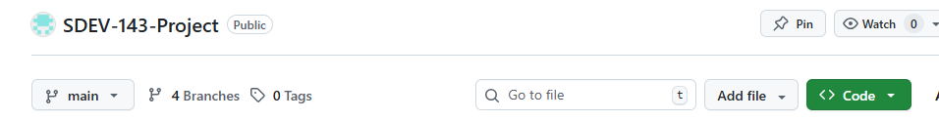
Click branches to see your branches that have been created.
New branch

Slide 17
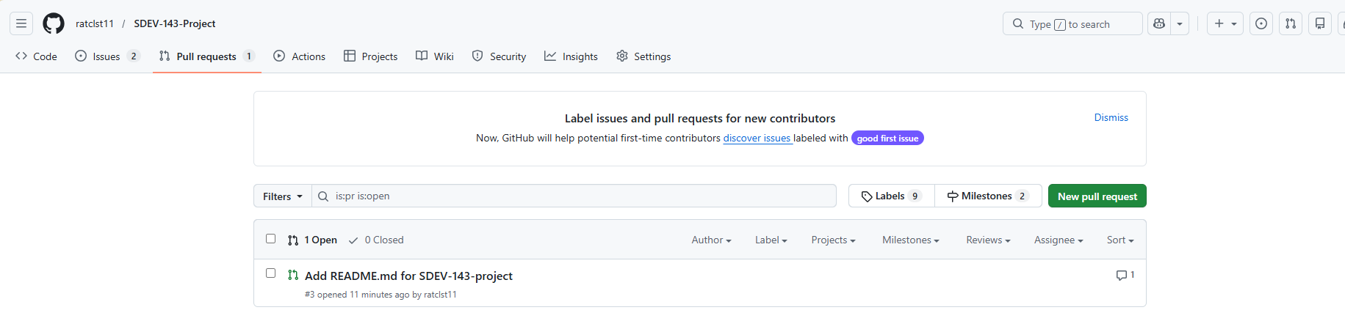
Moving README from demo branch to main branch
Select Pull requests
Select GREEN New pull request

Slide 18
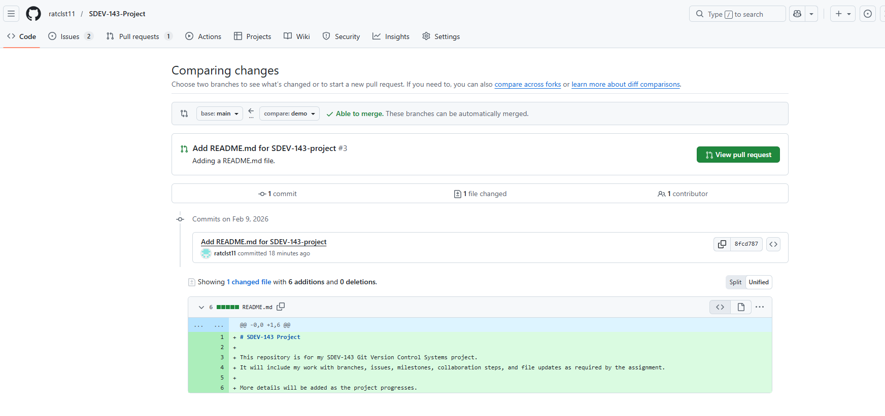
Click GREEN View pull request
Make sure of the following match
base: main
Compare: demo
File that is moving.

Slide 19
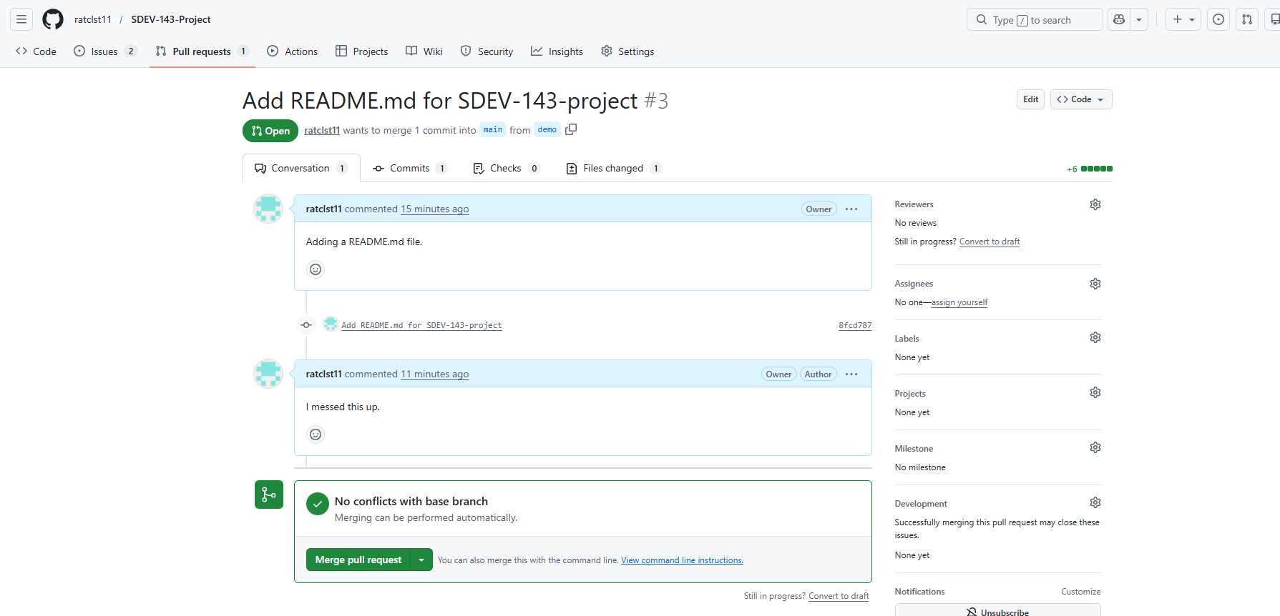
Click GREEN Merge pull request

Slide 20
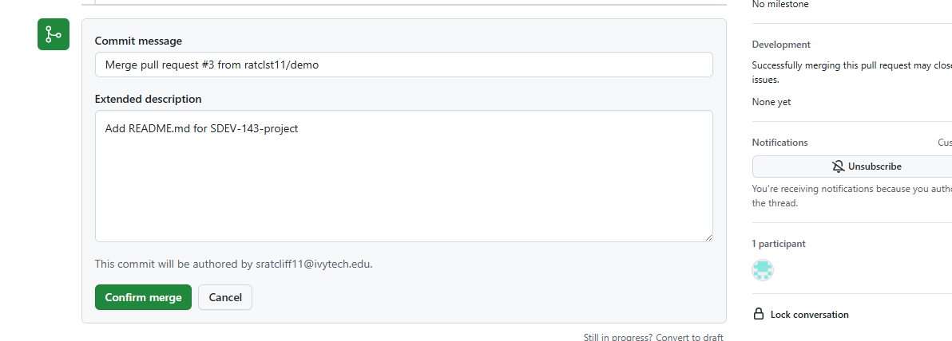
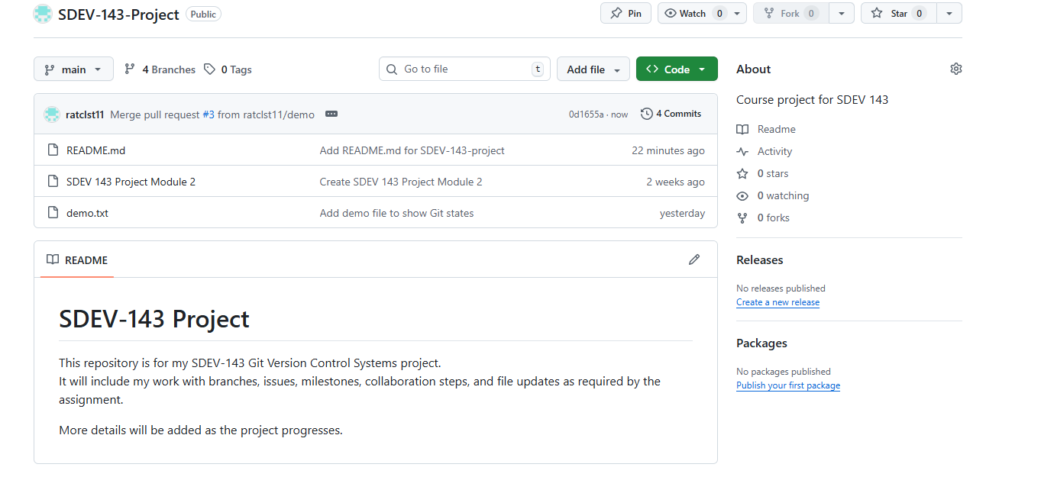
Click GREEN Confirm merge
The README.md back on main branch

Slide 21
Module 6

Slide 22
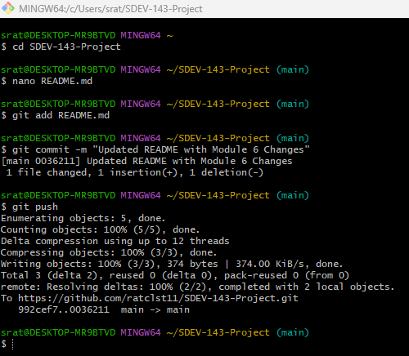
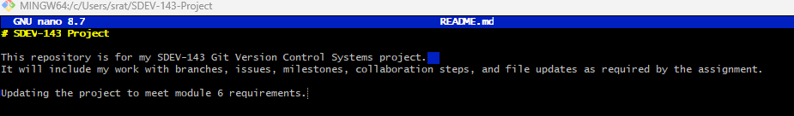
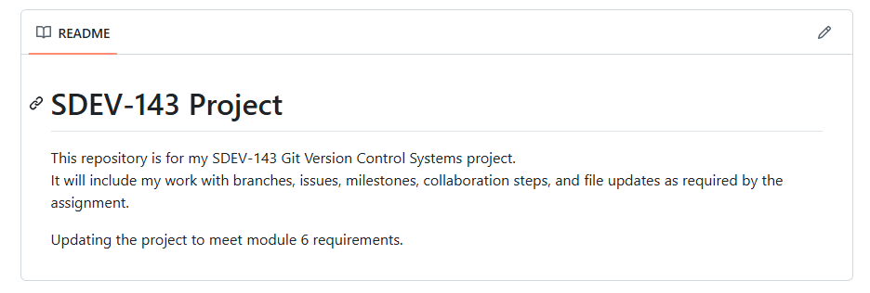
In SDEV 143 Project
Change in README.md
Stage the file
Commit the change
Push the commit
Change a line in the file nano README.md
Change made on my repo

Slide 23
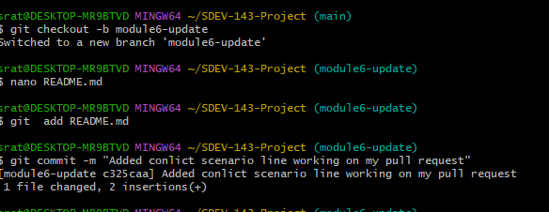
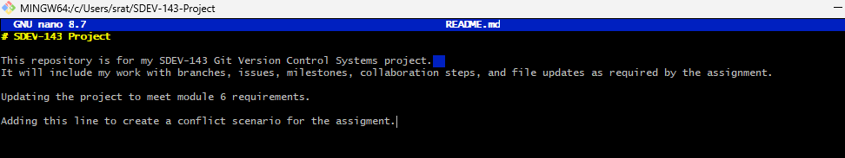
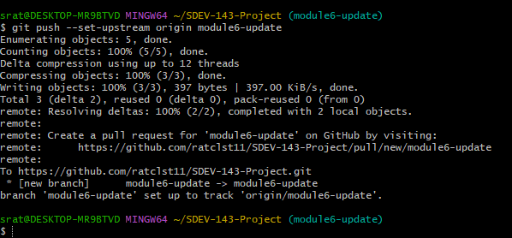
Created a new branch
Pull Request
Changed a file README.md
Stage the file
Commit the change
Added a line in the file
Push the commit

Slide 24
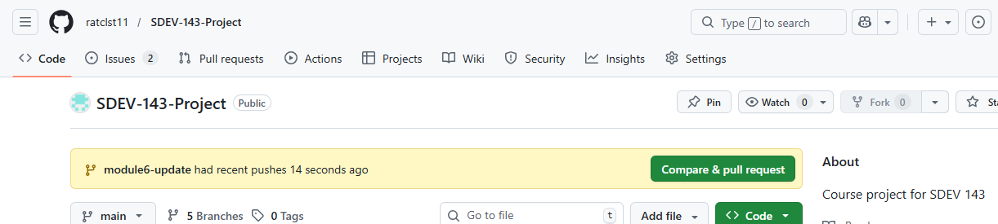
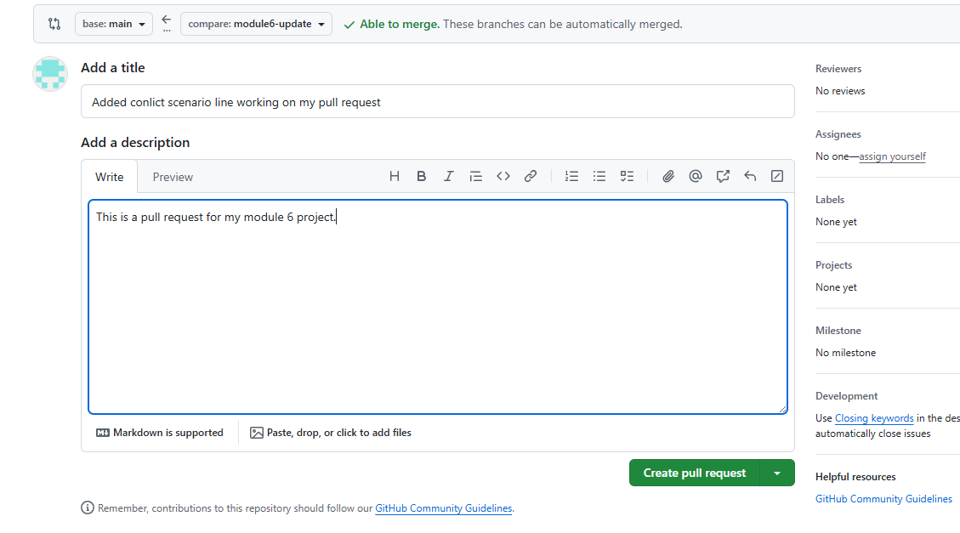
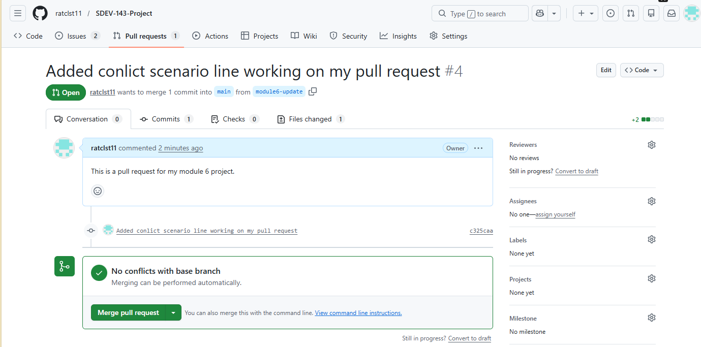
On my repo click GREEN Compare & pull request
Added a title and description. Click GREEN create pull request
Pull request complete with no issues

Slide 25
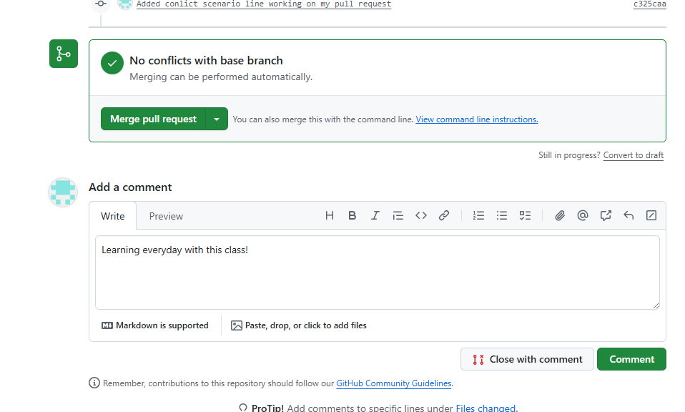
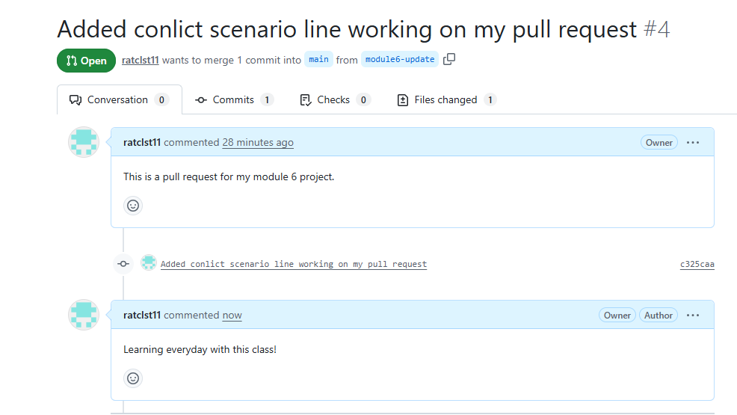
Added a comment
Click GREEN Comment button
Shows the comment

Slide 26
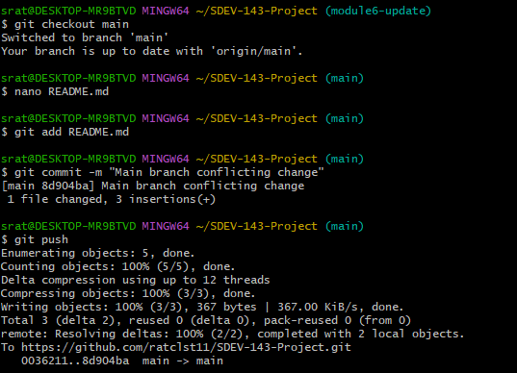
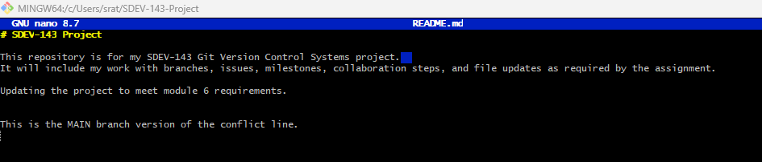
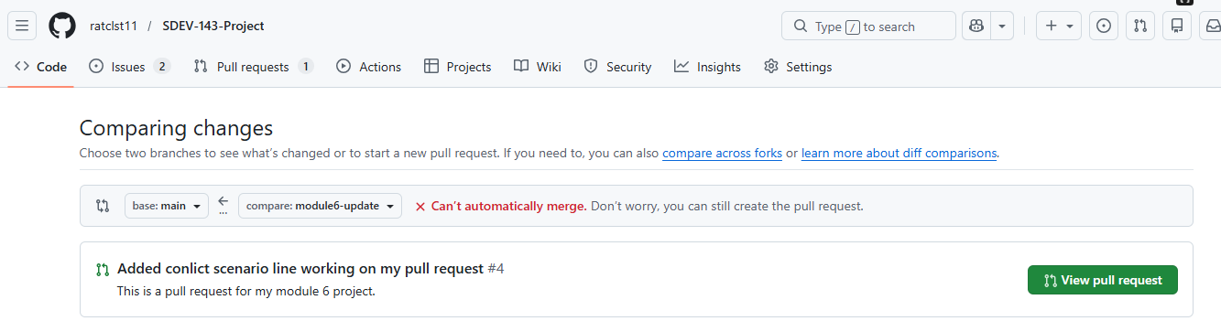
Making sure everything is up to date.
Creating a conflict and resolving it
Commit the change
Change a line in the file
Push the commit
Click GREEN View pull request

Slide 27
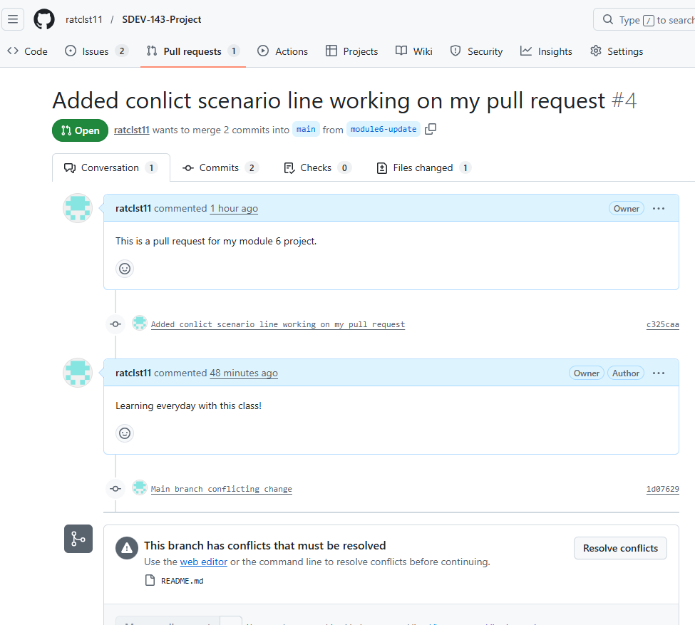
Pull request page
Conflict
Click Resolve the conflicts button

Slide 28
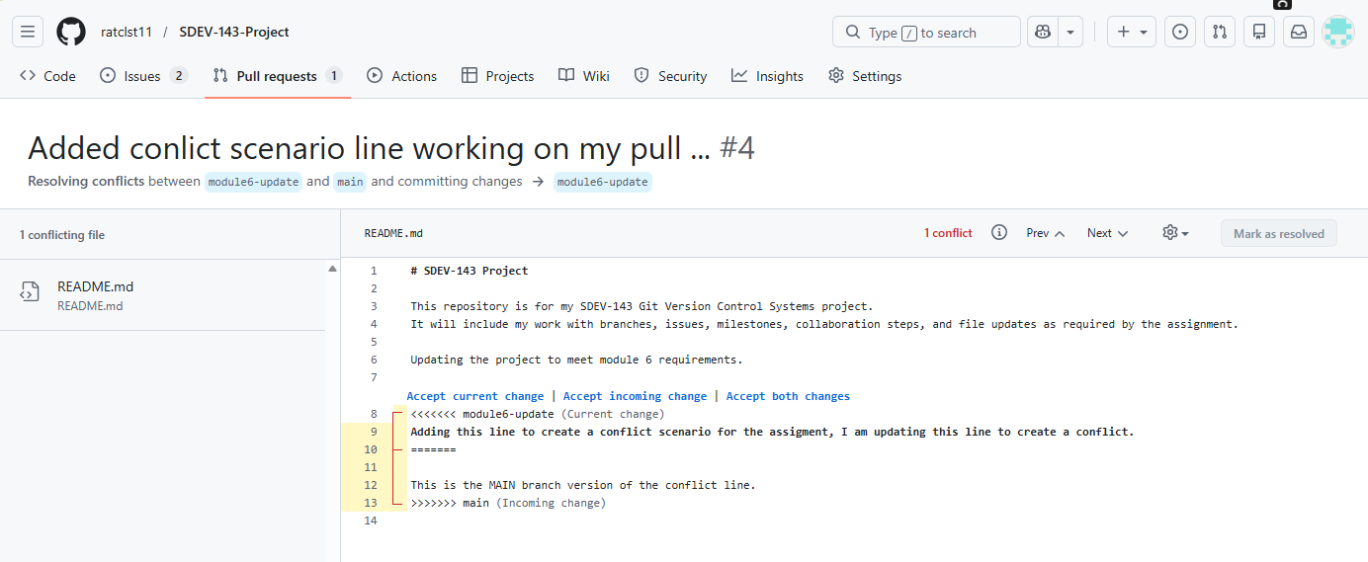
Conflict
Conflict Markers
<<<<<<< main
=======
>>>>>>> module6-update

Slide 29
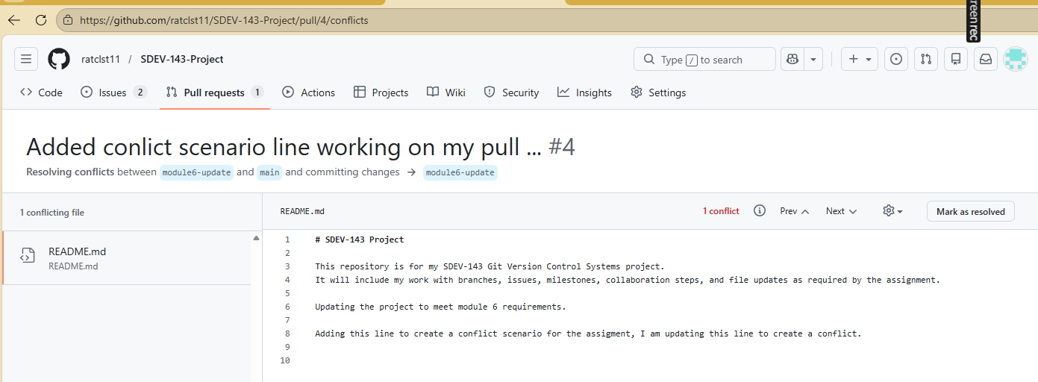
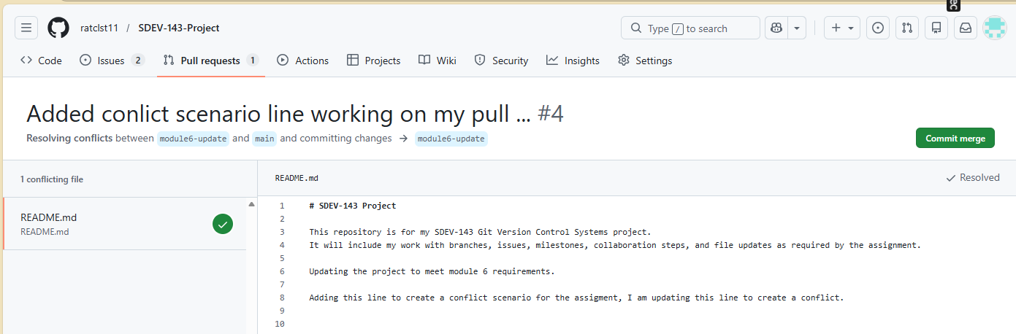
Cleaned up the conflict.
Click the GREEN Commit merge button.

Slide 30
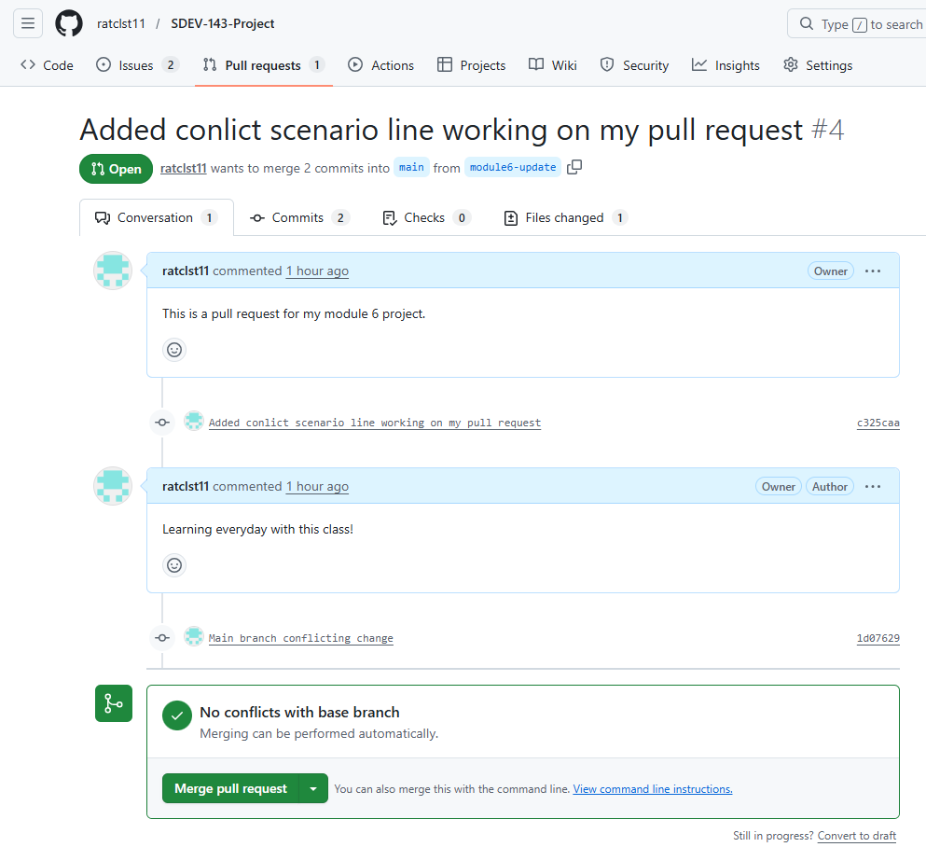
Shows conflict was resolved

Slide 31
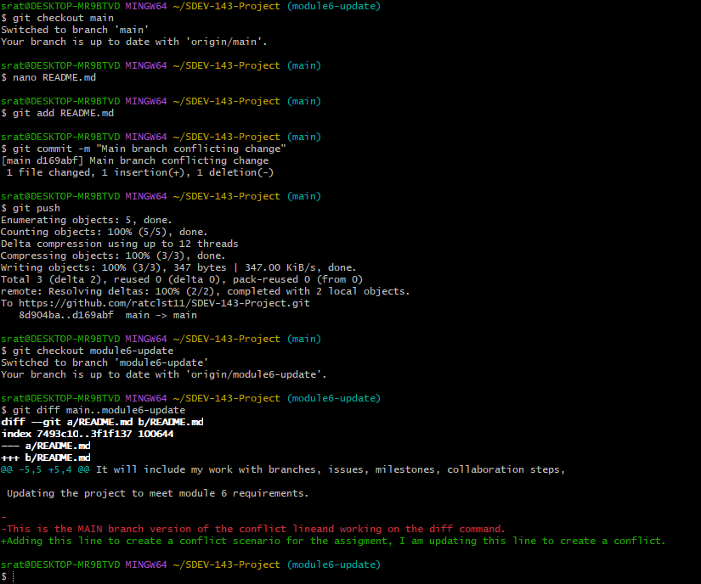
Diff Command
Created a change to a file.
Used the diff command to see differences.

Slide 32
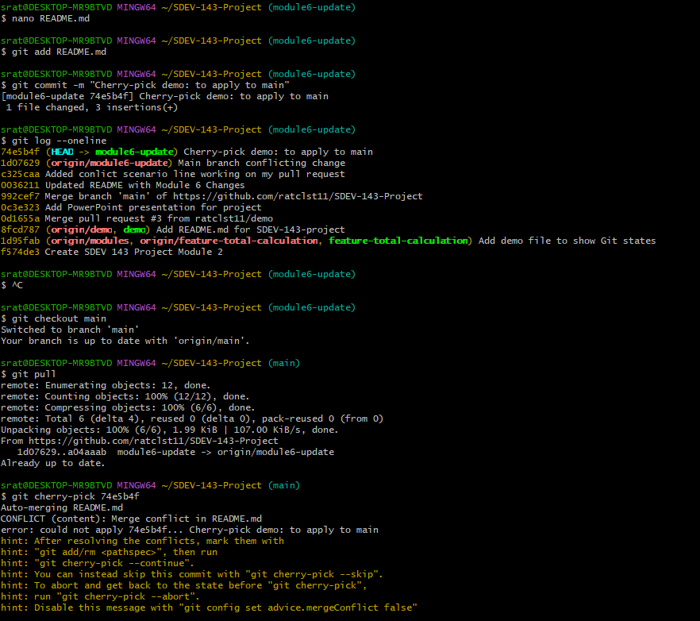
Changed README.md file
Committed the file I changed
Checked history with –oneline command
Found the commit ID for the cherry-pick 74e5b4f
Switched branches
Pull
Cherry-Picking 74e5b4f

Slide 33
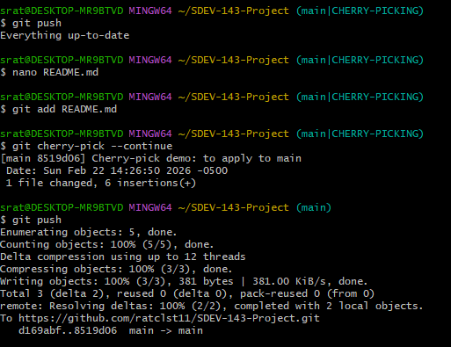
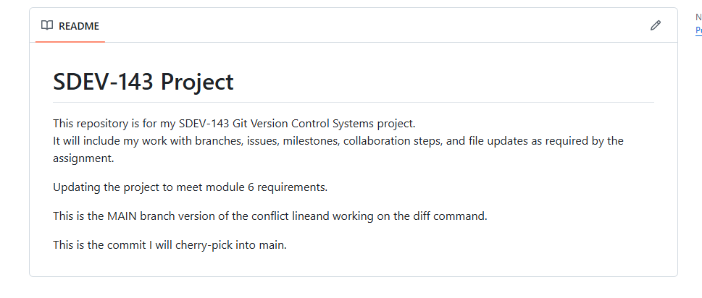
Had a conflict
(main|CHERRY-PICKING)
Resolved conflict in the README.md file
Continued the cherry-pick
Pushed changes to the repo
The line that I added for cherry-pick

Slide 34
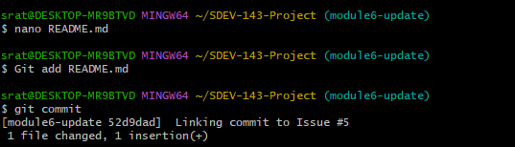


Changed file
Staged file
Using commit to link #5 issue
Pushed to the repo

Slide 35

Link an issue with a commit

Slide 36
Module 8

Slide 37


Select Settings
Select a Repo
Select Pages

Slide 38


Under build and deployment
Source: Deploy from a branch
Branch: Choose Main
Folder: Choose /root
Choose Save
Set up GitHub pages
Wait for your site to build
After your site is built it will show at the top if your GitHub Pages
Your new site

Slide 39


Slide 40


Changed to Lakes branch
Scenario for Merge Changes
Change List of Lakes.txt
Added a lake
Pushed changes to my repo
Changed to main branch
Changed List of Lakes.txt
Added a lake-Different line
Pushed changes to my repo

Slide 41




Slide 42


Insert a title and add a description
Select Create a Pull Request
Click Merge Request

Slide 43


Click to confirm merge
Shows completed merge.

Slide 44

Revert changes
Pull to make sure everything is up to date
Revert the commit b21ab65
Push to the Repo

Slide 45


Confirming or editing the commit message for the new revert commit
Revert complete

Slide 46


Everything that changed in Lakes since it branched off from main
Review a branch diff before deleting
Shows the difference between the latest commit on main and the latest commit on lakes

Slide 47


Deleting a branch
Restoring a deleted branch

Slide 48
Workflow Process
I began my workflow by creating a new feature branch where I could make changes without affecting the main branch. After editing my files, I staged and committed the changes locally, then pushed the branch to GitHub. Once the branch was published, I opened a pull request to merge the updates into the main branch. Before deleting the branch, I reviewed the branch diff to confirm exactly what changes were introduced. After verifying the diff, I deleted the feature branch and later restored it using the commit reference associated with that branch. Finally, I demonstrated how to revert a previous change by creating a revert commit. This full sequence represents a complete Git workflow from branch creation through merging, cleanup, restoration, and change reversal.

